Slide 1
Python Type Inference
Travis Chambers

Slide 2
Overview
Python Typing
Introduction
Pros/Cons
Prior Work
Goals
Applications
Current Work
Future Work
Challenges

Slide 3
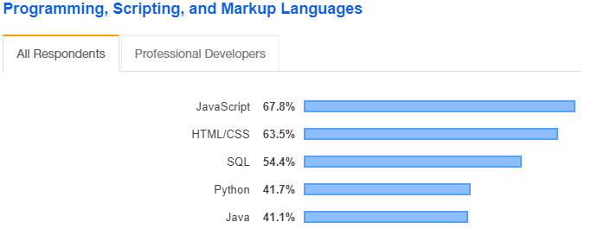
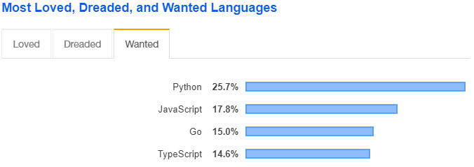
Dynamically Typed Languages
JavaScript -> TypeScript
Python -> typing module
https://insights.stackoverflow.com/survey/2019#technology
Notes:
https://docs.python.org/3/library/typing.html
https://www.python.org/dev/peps/pep-0484/
https://www.python.org/dev/peps/pep-0526/

Slide 4
Why Typing?
15% of bugs in JavaScript could be prevented by type annotations
Lack of types:
Hard to understand APIs
Difficult to read, maintain, and document
Poor IDE support
Notes:
Gao – To Type or Not to Type: On the Effectiveness of Static Typing for JavaScript 2017 IEEE
How can an IDE suggest autocompletions if it doesn’t know the type? Just suggest all variables in a file?

Slide 5

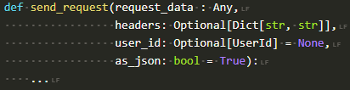
Python Typing
PEP 3107 – Function Annotations – Dec 2006
PEP 484 – Type Hints – Sept 2014
PEP 526 – Variable Annotations – Aug 2016
Typing officially supported with Python 3.6 (released Dec 23, 2016)

Slide 6
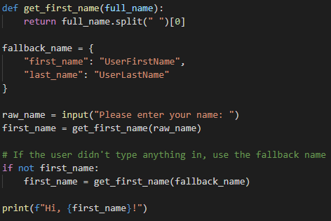
Pros
Can you see the bug?
Without types, get_first_name() only errors at runtime
If type annotations are added, static analysis catches this bug

Slide 7
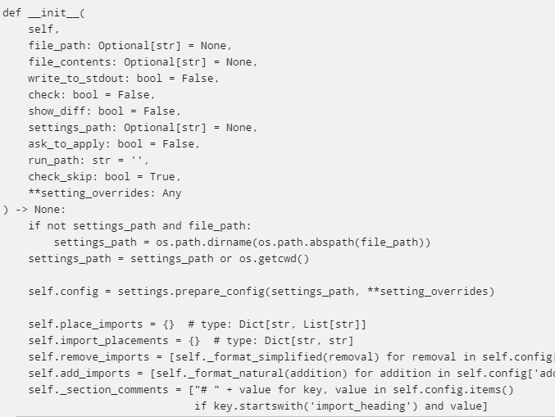
Cons
Not that popular
If used poorly, can decrease readability
Where does the function declaration end and the function body begin?
Notes:
Where does the function declaration end and the function body begin? isort - https://github.com/timothycrosley/isort
Tale - https://github.com/irmen/Tale
FastAPI - https://github.com/tiangolo/fastapi

Slide 8
Prior Work
NLP Type Inference
DeepTyper – JavaScript/TypeScript
JSNice – JavaScript
NL2Type – JavaScript
Static Type Inference
Typpete – Python – Z3 SMT Solver
Python Probabilistic Type Inference
Notes:
Nobody using python type hints to train on. Instead, they use those derived from data flow, attribute accesses, and variable names.

Slide 9
Goals
Increase popularity of typing in python
Mine GitHub for dataset of python files using the typing module
Parse/Tokenize dataset
Train on dataset to produce a model that can predict types in a python file
Mine GitHub for repos using python 3.6+
Generate PRs to these repos to add type hints
Ease burden of adding type hints

Slide 10
Applications
Standalone Tool – Mine GitHub for projects using python 3.6 or later and create PRs with type hints added.
IDE Features – Suggest types, better autocomplete for function declarations, docstrings, etc.
Static Analysis – Find inconsistencies between docstrings, function signatures, variable type hints, etc.
Notes:
Python 3.6 required since that’s when typing module was introduced

Slide 11
Generated Code Corpus
No existing corpus of python code using type hints
Mined GitHub manually
Total typed: 2064
Total typed lines of code: 1,068,993
Corpus is too small!
Flair suggests ~1 billion tokens
Notes:
Spent around 8-10 hours searching on github and downloading repos to generate the corpus. With another 30-40 hours I think a large enough dataset could be generated to be really useful. "from typing import" NOT "rasa_nlu" -filename:ann_module.py -filename:basecommand.py -filename:typing.py -filename:test.py extension:.py

Slide 12
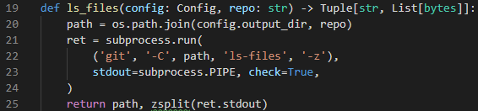
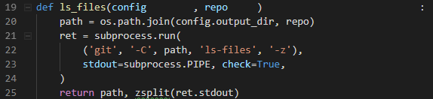
Stripped Type Hints

Slide 13

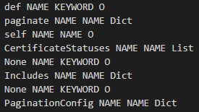
Tokenized

Slide 14
Flair
A very simple framework for state-of-the-art NLP. Developed by Zalando Research.
Built directly on PyTorch
https://github.com/zalandoresearch/flair

Slide 15
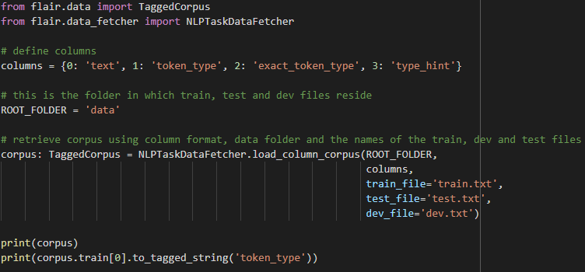
Load Custom Corpus

Slide 16
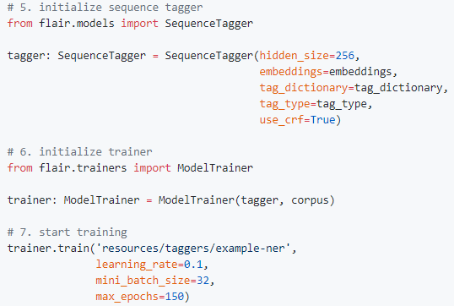
Train Model
On hold until I get GPU access
Ran out of Google Cloud credits
Requested access to LLNLs supercomputing resources, waiting on approvals

Slide 17
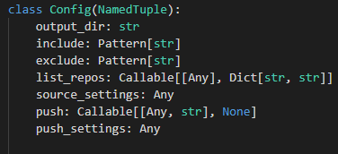
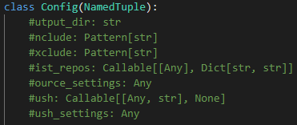
Challenges
Class variable annotations get completely stripped, since without the annotation it’s invalid code
Notes:
Since a type alias actually gets stripped out, since it is a type annotation itself. But then, how can we predict a type annotation might have actually been an alias?

Slide 18
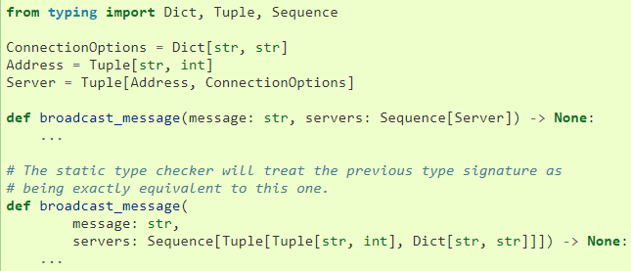
Challenges
Type aliases make it difficult to tokenize/predict accurately

Slide 19
References
Survey Data https://insights.stackoverflow.com/survey/2019#technology
DeepTyper http://vhellendoorn.github.io/PDF/fse2018-j2t.pdf https://github.com/DeepTyper/DeepTyper
Flair http://alanakbik.github.io/papers/coling2018.pdf https://github.com/zalandoresearch/flair

